Slide 1
Cornerstone City Church Peninsula Plus Community Hoo Are Ya 11-06-2023

Slide 2
Heart Of Worship CCLI Song # 2296522
Matt Redman
© 1997 Thankyou Music (Admin. by Integrity Music Ltd)
For use solely with the SongSelect® Terms of Use. All rights reserved. www.ccli.com
CCLI Licence No. 33265

Slide 3
1/4
When the music fades all is stripped away
And I simply come
Longing just to bring something that's of worth
That will bless Your heart

Slide 4
2/4
I'll bring You more than a song
For a song in itself is not what You have required
You search much deeper within
Through the way things appear
You're looking into my heart

Slide 5
3/4
I'm coming back to the heart of worship
And it's all about You all about You Jesus
I'm sorry Lord for the thing I've made it
When it's all about You all about You Jesus

Slide 6
4/4
King of endless worth no one could express
How much You deserve
Though I'm weak and poor all I have is Yours
Ev'ry single breath

Slide 7


Slide 8
Worthy
CCLI Song # 7111931
Chris Brown | Mack Brock | Steven Furtick
© Music by Elevation Worship Publishing (Admin. by Essential Music Publishing LLC)
For use solely with the SongSelect® Terms of Use. All rights reserved. www.ccli.com
CCLI Licence No. 33265

Slide 9
1/4
It was my cross You bore
So I could live in the freedom You died for
And now my life is Yours
And I will sing of Your goodness forevermore

Slide 10
2/4
Worthy is Your name, Jesus
You deserve the praise
Worthy is Your name
Worthy is Your name, Jesus
You deserve the praise
Worthy is Your name

Slide 11
3/4
And now my shame is gone
I stand amazed in Your love undeniable
Your grace goes on and on
And I will sing of Your goodness forevermore

Slide 12
4/4
Be exalted now in the heavens
As Your glory fills this place
You alone deserve our praise
You're the name above all names

Slide 14
Blessed Be Your Name
CCLI Song # 3798438
Beth Redman | Matt Redman
© 2002 Thankyou Music (Admin. by Integrity Music Ltd)
For use solely with the SongSelect® Terms of Use. All rights reserved. www.ccli.com
CCLI Licence No. 33265

Slide 15
1/7
Blessed be Your name
In the land that is plentiful
Where Your streams of abundance flow
Blessed be Your name

Slide 16
2/7
Blessed be Your name
When I'm found in the desert place
Though I walk through the wilderness
Blessed be Your name

Slide 17
3/7
Ev’ry blessing You pour out I’ll
Turn back to praise
When the darkness closes in Lord
Still I will say

Slide 18
4/7
Blessed be the name of the Lord
Blessed be Your name
Blessed be the name of the Lord
Blessed be Your glorious name

Slide 19
5/7
Blessed be Your name
When the sun's shining down on me
When the world's all as it should be
Blessed be Your name

Slide 20
6/7
Blessed be Your name
On the road marked with suffering
Though there's pain in the offering
Blessed be Your name

Slide 21
7/7
You give and take away
You give and take away
My heart will choose to say
Lord blessed be Your name

Slide 23
I Speak Jesus
CCLI Song # 7136201
Abby Benton | Carlene Prince | Dustin Smith | Jesse Reeves | Kristen Dutton | Raina Pratt
© 2019 Here Be Lions Publishing (Admin. by Integrity Music Ltd)
Integrity's Praise! Music (Admin. by Integrity Music Ltd)
BEC Worship (Admin. by Song Solutions)
Raina Pratt publishing designee (Admin. by Song Solutions www.songsolutions.org)
WriterWrong Music (Admin. by Song Solutions www.songsolutions.org)
Remaining portion is unaffiliated
For use solely with the SongSelect® Terms of Use. All rights reserved. www.ccli.com
CCLI Licence No. 33265

Slide 24
1/5
I just want to speak the Name of Jesus
Over ev'ry heart and ev'ry mind
'Cause I know there is peace within Your presence
I speak Jesus

Slide 25
2/5
I just want to speak the Name of Jesus
'Til ev'ry dark addiction starts to break
Declaring there is hope and there is freedom
I speak Jesus

Slide 26
3/5
('Cause) Your Name is power
Your Name is healing
Your Name is life
Break ev'ry stronghold
Shine through the shadows
Burn like a fire

Slide 27
4/5
I just want to speak the Name of Jesus
Over fear and all anxiety
To ev'ry soul held captive by depression
I speak Jesus

Slide 28
5/5
Shout Jesus from the mountains
Jesus in the streets
Jesus in the darkness over ev'ry enemy
Jesus for my fam'ly
I speak the holy Name Jesus

Slide 29


Slide 30
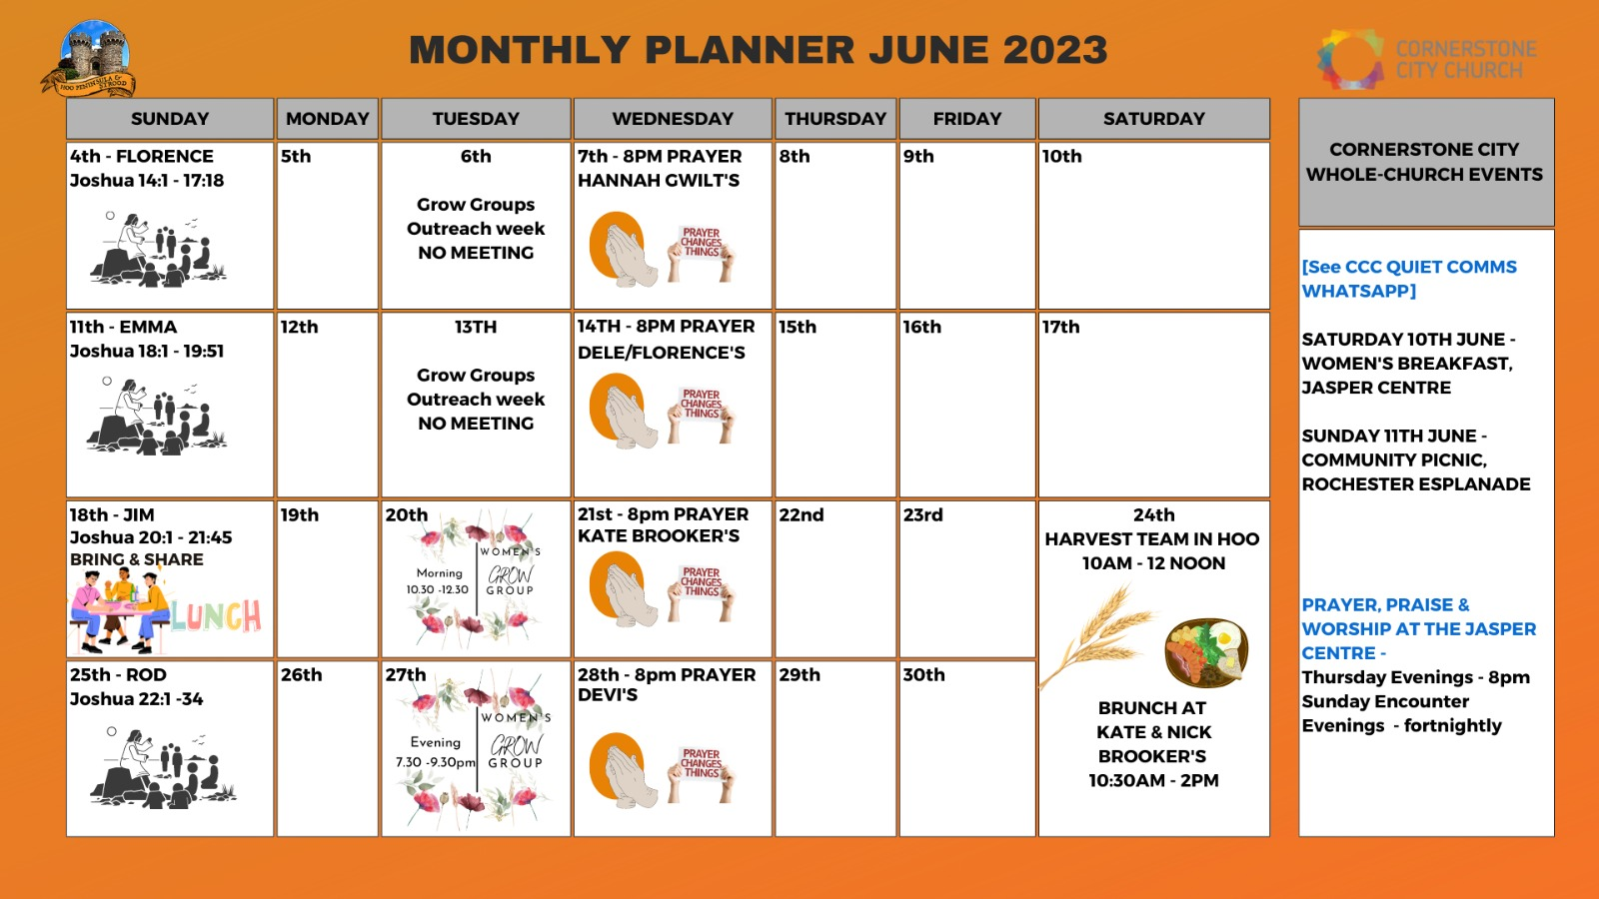

Slide 31


Slide 32
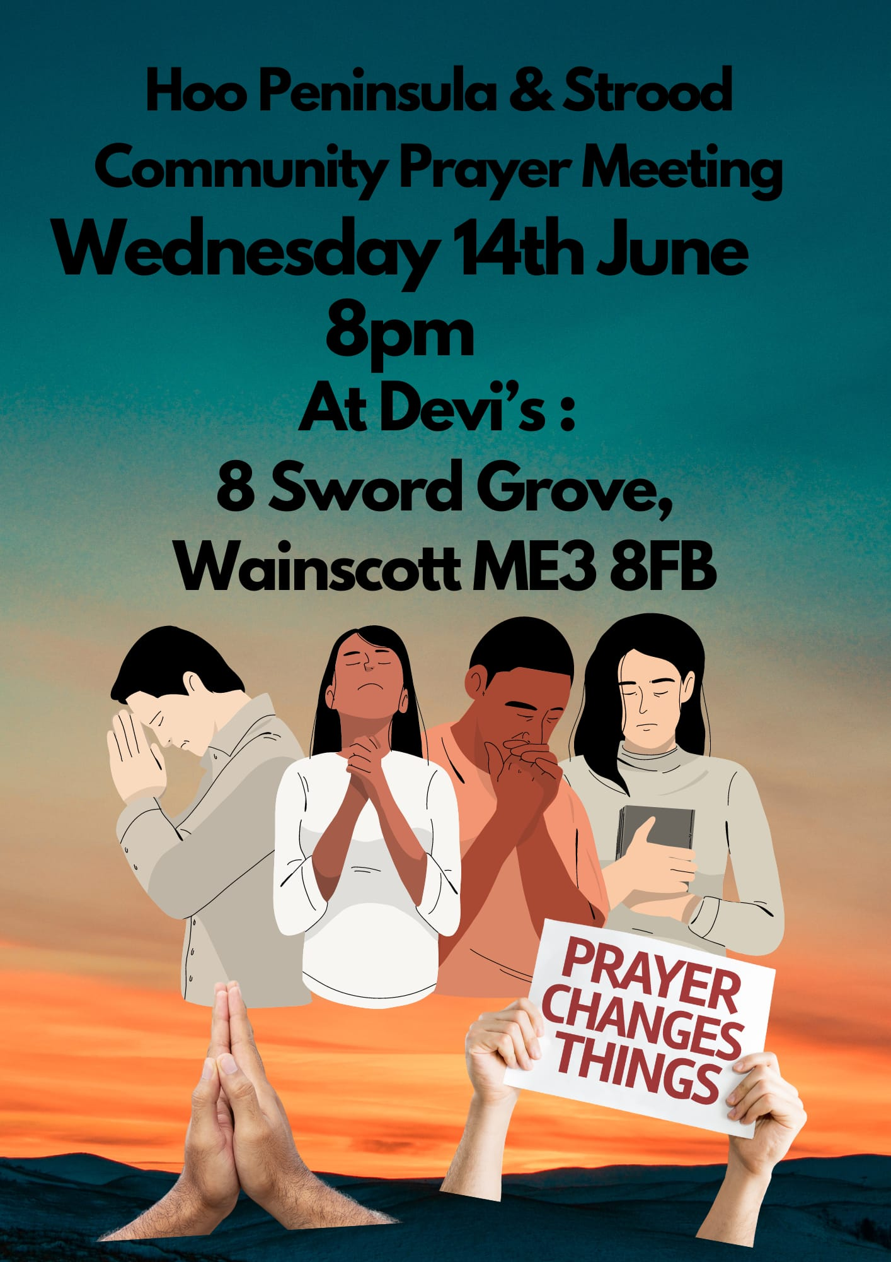

Slide 33


Slide 34


Slide 35


Slide 36


Slide 37

18th June 7.30 PM

Slide 38


Slide 39


Slide 40


